Slide 1

Task 3 - Indian
Parliamentary Elections 2024
Results Dashboard
(By Siddhant Ghosh)
Data Analyst Internship @ Mentorness

Slide 2
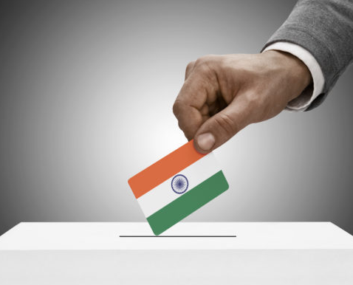
Introduction
Indian Parliamentary elections is the largest voting exercise in the world. This years general elections in India were conducted over a historic 44 day period, aiming to elect 543 members to the 18th Lok Sabha. With the given dataset of results in this election , I have created an interactive PowerBI dashboard to visually interpret the mandate of Indian citizens.

Slide 3
About the Dataset
The two datasets I was given had been incomplete and also had some missing values. I used
Excel
PowerBI power query
To solve those issues. One dataset contained all the details about the result of each constituencies and the other dataset contained info about the parties and their parties.
Election Results Dataset: -
`_id`: Unique identifier for each record. -
`State`: Name of the state. -
`Const. No.`: Constituency number. -
`Constituency`: Name of the constituency. -
`Leading Candidate`: Name of the leading candidate. -
`Leading Party`: Name of the leading party. - `
Trailing Candidate`: Name of the trailing candidate. -
`Trailing Party`: Name of the trailing party. -
`Margin`: Vote margin between the leading and trailing candidates.
`Status`: Status of the election result (e.g., Won, Lost, Leading, Trailing).
Party Alliance Dataset: -
`Party Name`: Name of the political party. -
`Alliance Name`: Name of the political alliance the party belongs to.

Slide 4
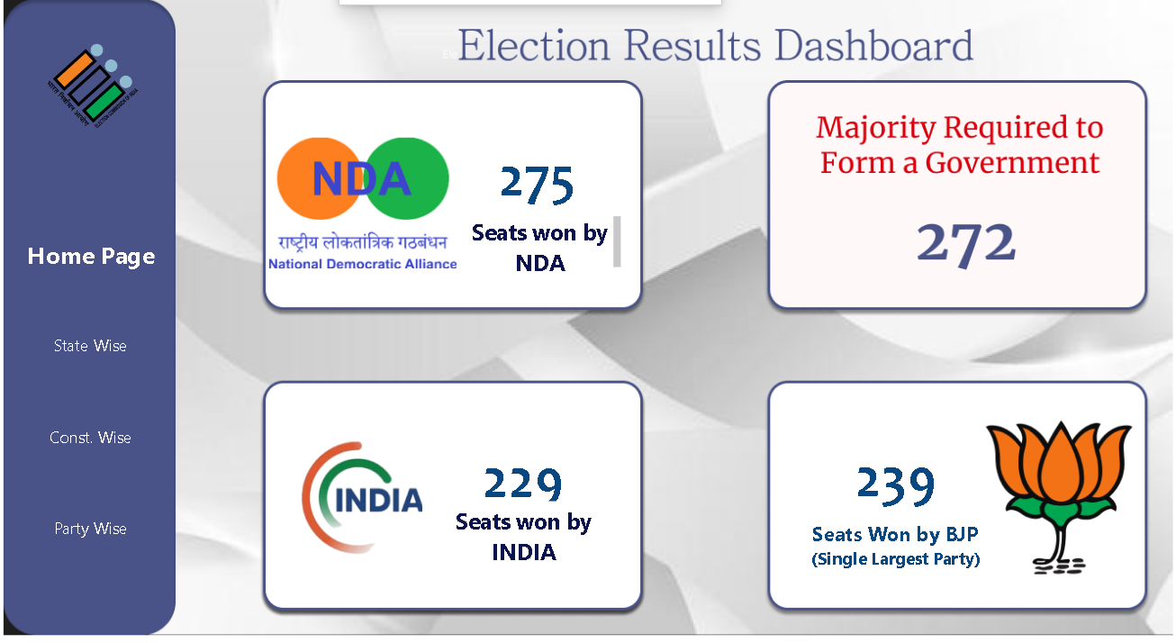
Election Results - Main Key points

Slide 5
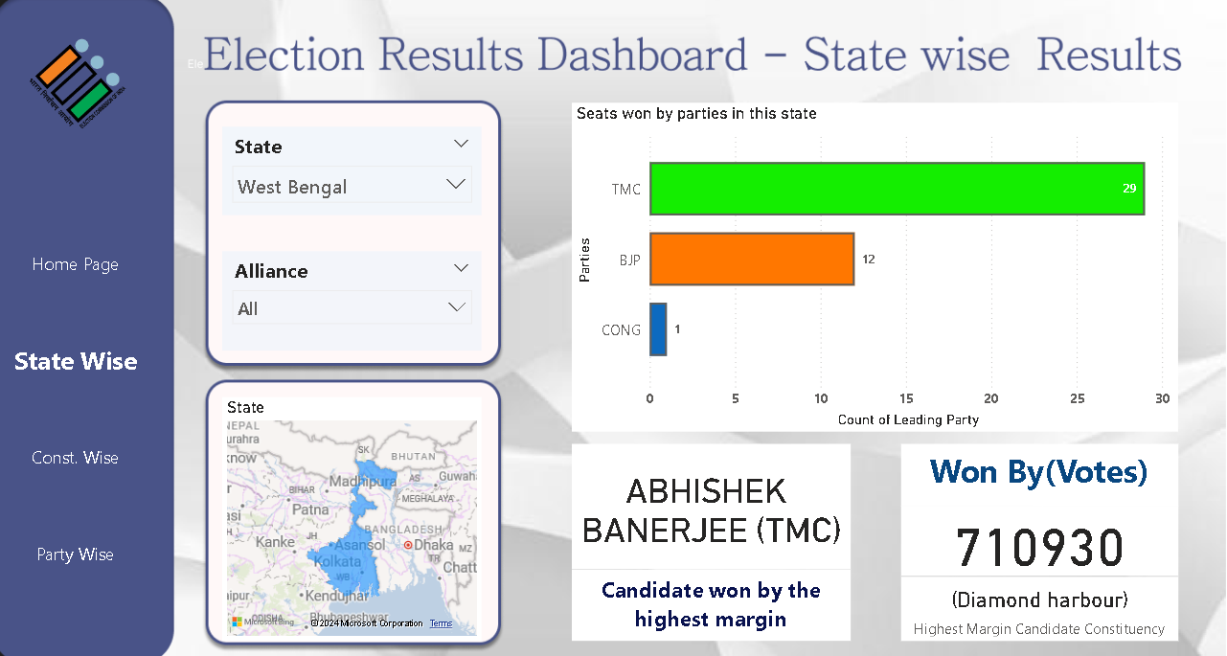
Election Results - State Wise Results

Slide 6
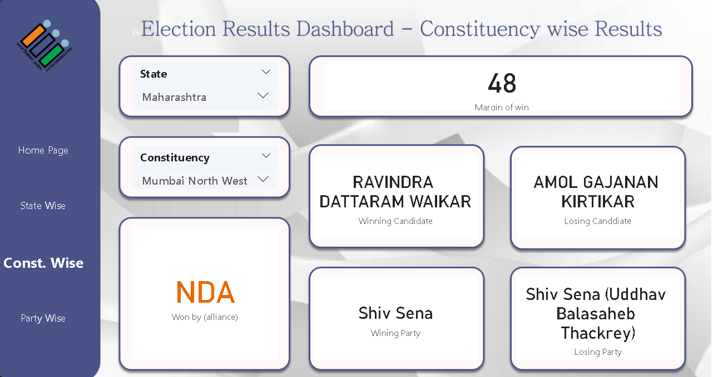
Election Results - Constituency Wise Results

Slide 7
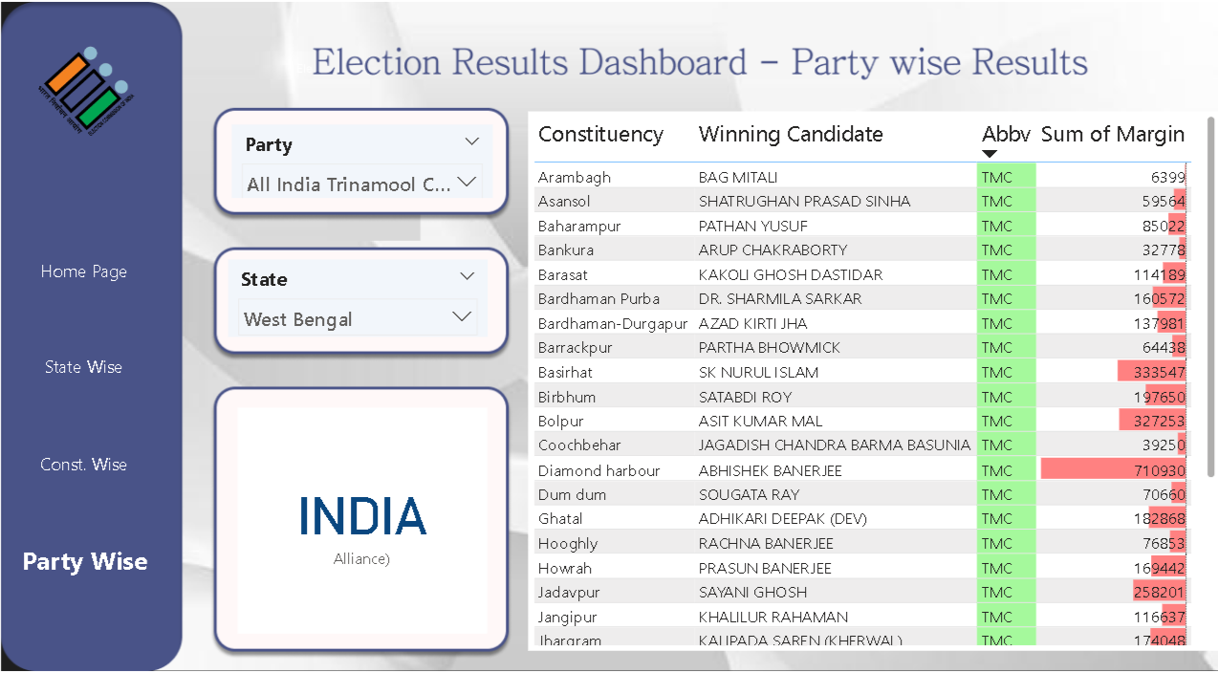
Election Results - Party Wise Results

Slide 8
Thanks everyone
For joining!

